Slide 1
The ArrayList Class
Slides prepared by Rose Williams, Binghamton University
Kenrick Mock, University of Alaska Anchorage

Slide 2
The ArrayList Class
ArrayList is a class in the standard Java libraries
Unlike arrays, which have a fixed length once they have been created, an ArrayList is an object that can grow and shrink while your program is running
In general, an ArrayList serves the same purpose as an array, except that an ArrayList can change length while the program is running

Slide 3
The ArrayList Class
The class ArrayList is implemented using an array as a private instance variable
When this hidden array is full, a new larger hidden array is created and the data is transferred to this new array

Slide 4
The ArrayList Class
Why not always use an ArrayList instead of an array?
An ArrayList is less efficient than an array
It does not have the convenient square bracket notation
The base type of an ArrayList must be a class type (or other reference type): it cannot be a primitive type
This last point is less of a problem now that Java provides automatic boxing and unboxing of primitives

Slide 5
Using the ArrayList Class
In order to make use of the ArrayList class, it must first be imported from the package java.util
An ArrayList is created and named in the same way as object of any class, except that you specify the base type as follows:
ArrayList<BaseType> aList =
new ArrayList<BaseType>();

Slide 6
Using the ArrayList Class
An initial capacity can be specified when creating an ArrayList as well
The following code creates an ArrayList that stores objects of the base type String with an initial capacity of 20 items
ArrayList<String> list =
new ArrayList<String>(20);
Specifying an initial capacity does not limit the size to which an ArrayList can eventually grow
Note that the base type of an ArrayList is specified as a type parameter

Slide 7
Using the ArrayList Class
The add method is used to set an element for the first time in an ArrayList
list.add("something");
The method name add is overloaded
There is also a two argument version that allows an item to be added at any currently used index position or at the first unused position

Slide 8
Using the ArrayList Class
The size method is used to find out how many indices already have elements in the ArrayList
int howMany = list.size();
The set method is used to replace any existing element, and the get method is used to access the value of any existing element
list.set(index, "something else");
String thing = list.get(index);

Slide 9
Tip: Summary of Adding to an ArrayList
The add method is usually used to place an element in an ArrayList position for the first time (at an ArrayList index)
The simplest add method has a single parameter for the element to be added, and adds an element at the next unused index, in order

Slide 10
Tip: Summary of Adding to an ArrayList
An element can be added at an already occupied list position by using the two-parameter version of add
This causes the new element to be placed at the index specified, and every other member of the ArrayList to be moved up by one position

Slide 11
Tip: Summary of Adding to an ArrayList
The two-argument version of add can also be used to add an element at the first unused position (if that position is known)
Any individual element can be changed using the set method
However, set can only reset an element at an index that already contains an element
In addition, the method size can be used to determine how many elements are stored in an ArrayList

Slide 12
Methods in the Class ArrayList
The tools for manipulating arrays consist only of the square brackets and the instance variable length
ArrayLists, however, come with a selection of powerful methods that can do many of the things for which code would have to be written in order to do them using arrays

Slide 13
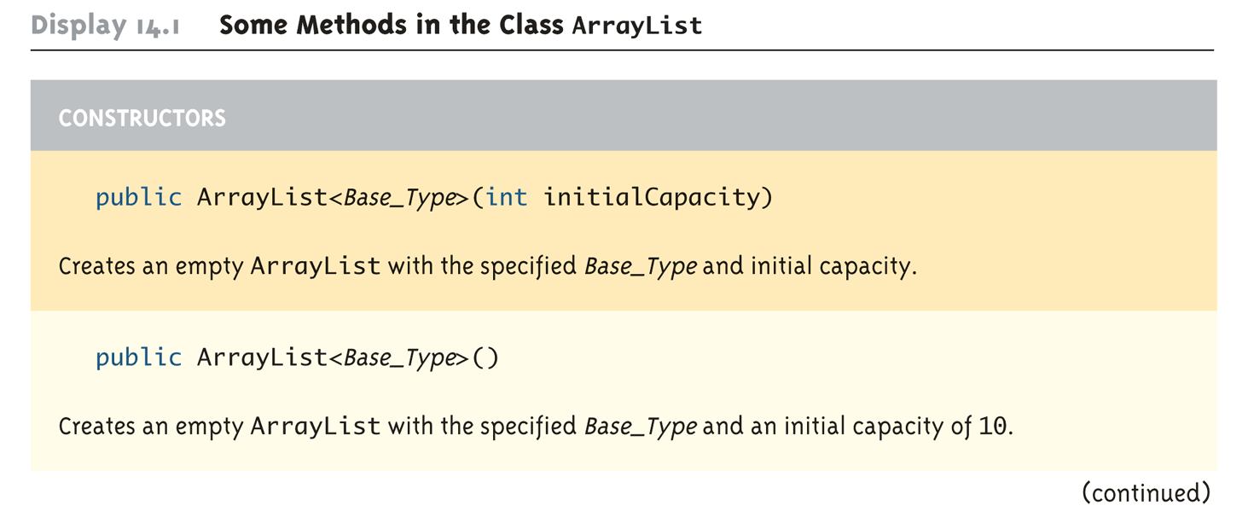
Some Methods in the Class ArrayList (Part 1 of 11)

Slide 14
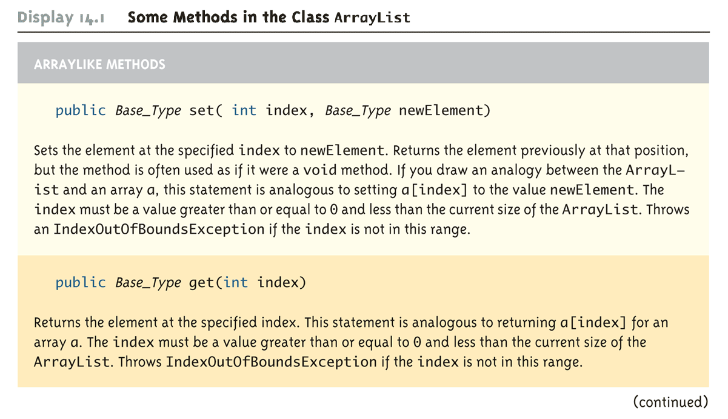
Some Methods in the Class ArrayList (Part 2 of 11)

Slide 15
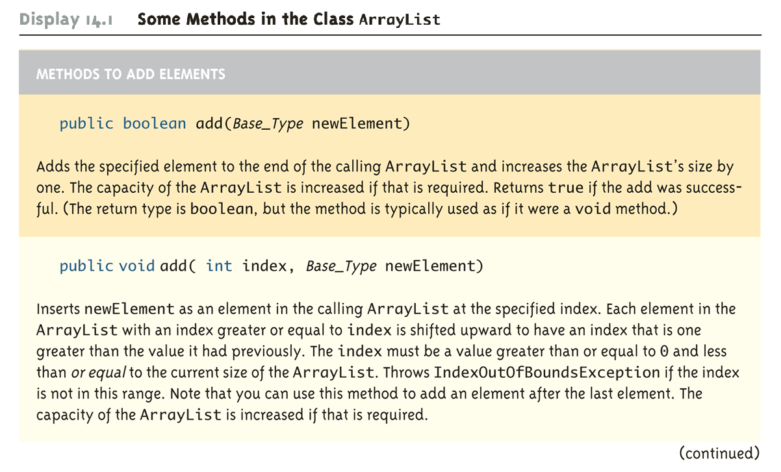
Some Methods in the Class ArrayList (Part 3 of 11)

Slide 16
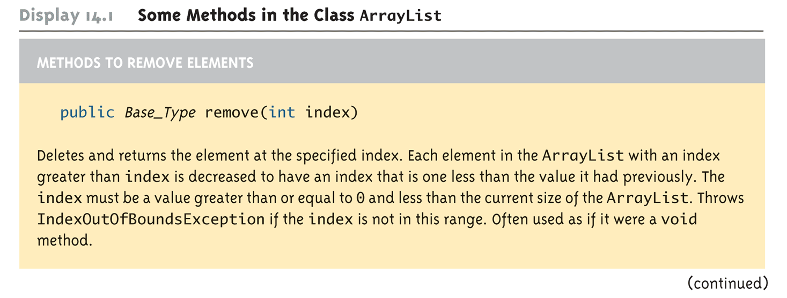
Some Methods in the Class ArrayList (Part 4 of 11)

Slide 17
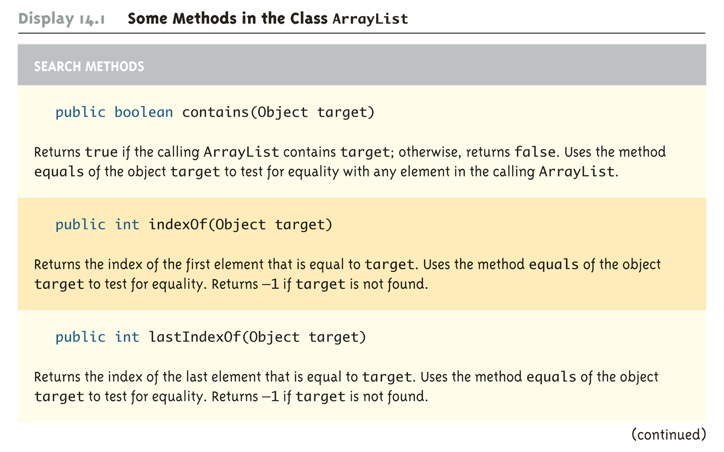
Some Methods in the Class ArrayList (Part 6 of 11)

Slide 18
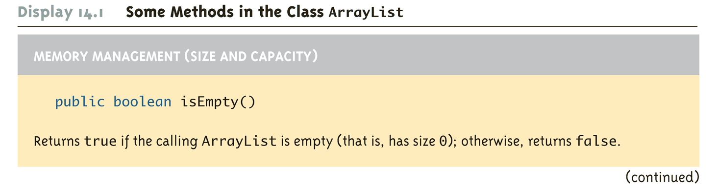
Some Methods in the Class ArrayList (Part 7 of 11)

Slide 19
The "For Each" Loop
The ArrayList class is an example of a collection class
Starting with version 5.0, Java has added a new kind of for loop called a for-each or enhanced for loop
This kind of loop has been designed to cycle through all the elements in a collection (like an ArrayList)

Slide 20
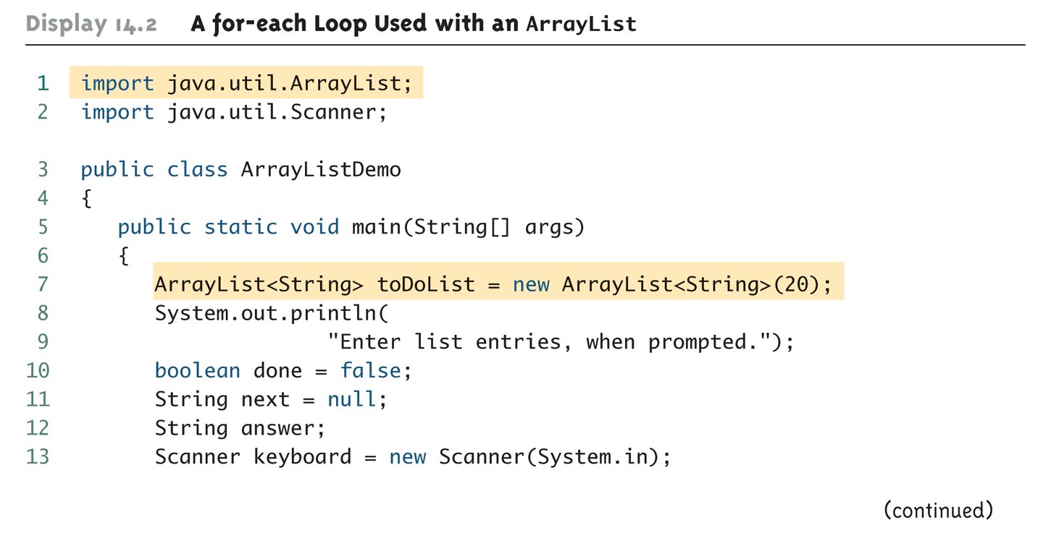
A for-each Loop Used with an ArrayList (Part 1 of 3)

Slide 21
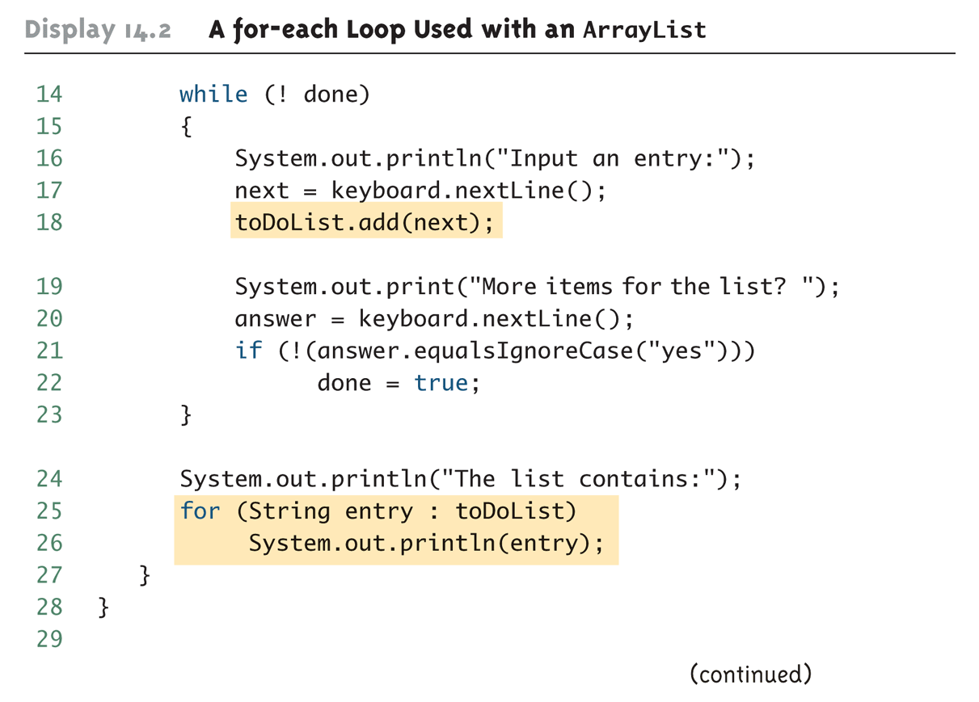
A for-each Loop Used with an ArrayList (Part 2 of 3)

Slide 22
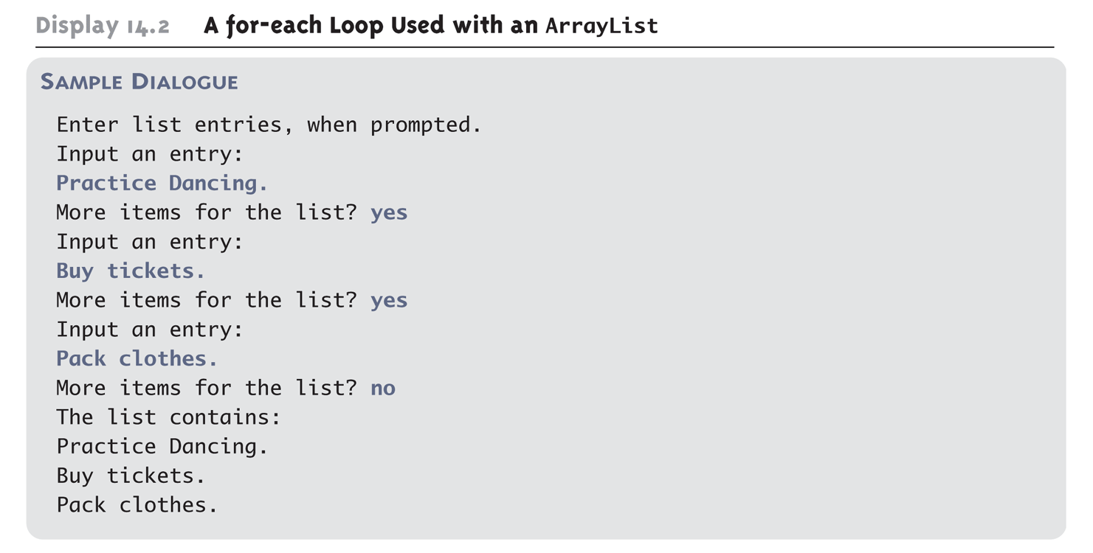
A for-each Loop Used with an ArrayList (Part 3 of 3)

Slide 23
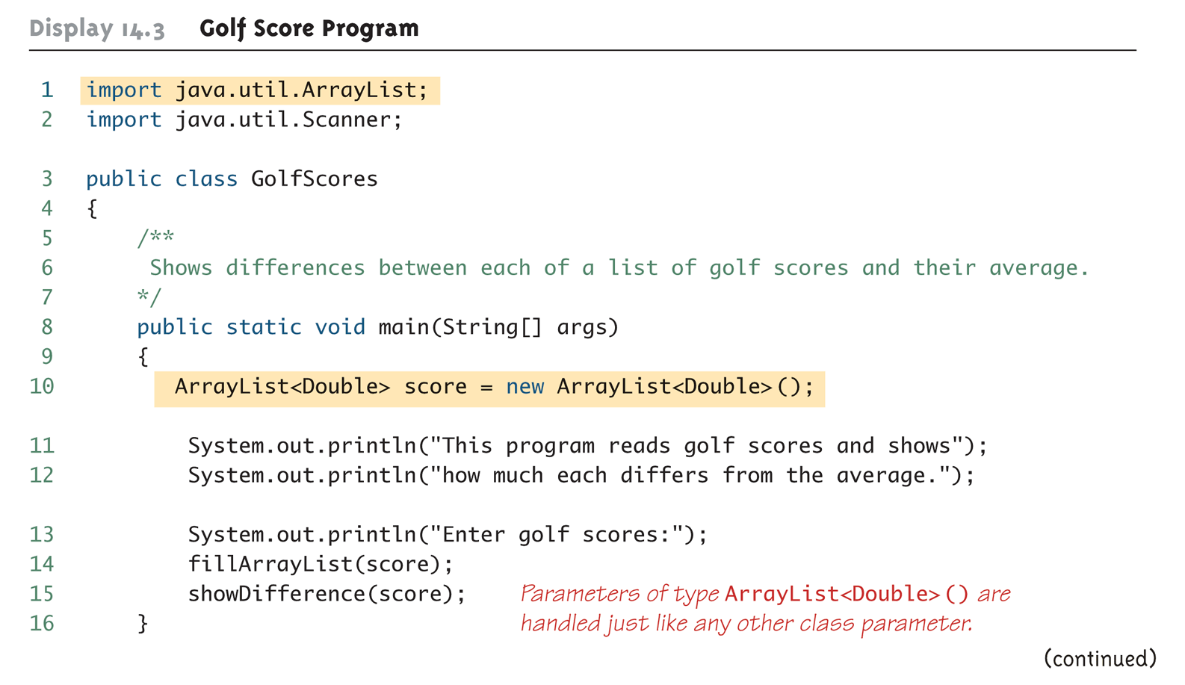
Golf Score Program (Part 1 of 6)

Slide 24
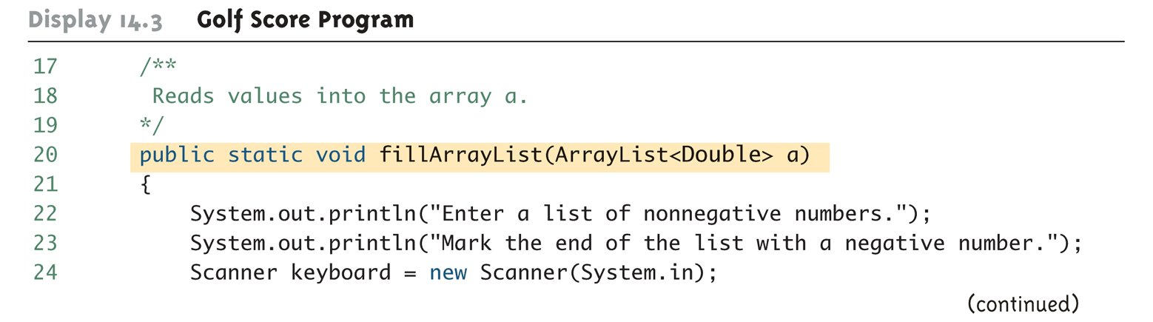
Golf Score Program (Part 2 of 6)

Slide 25
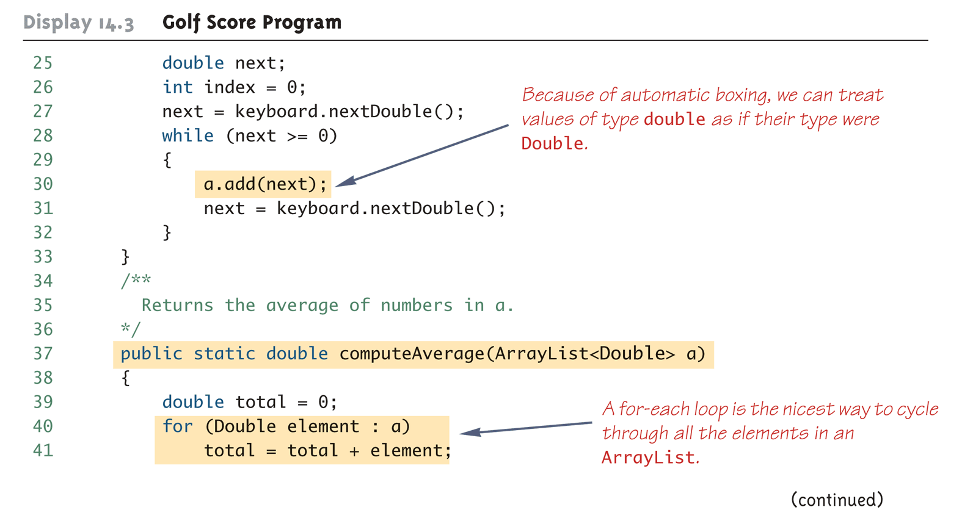
Golf Score Program (Part 3 of 6)

Slide 26
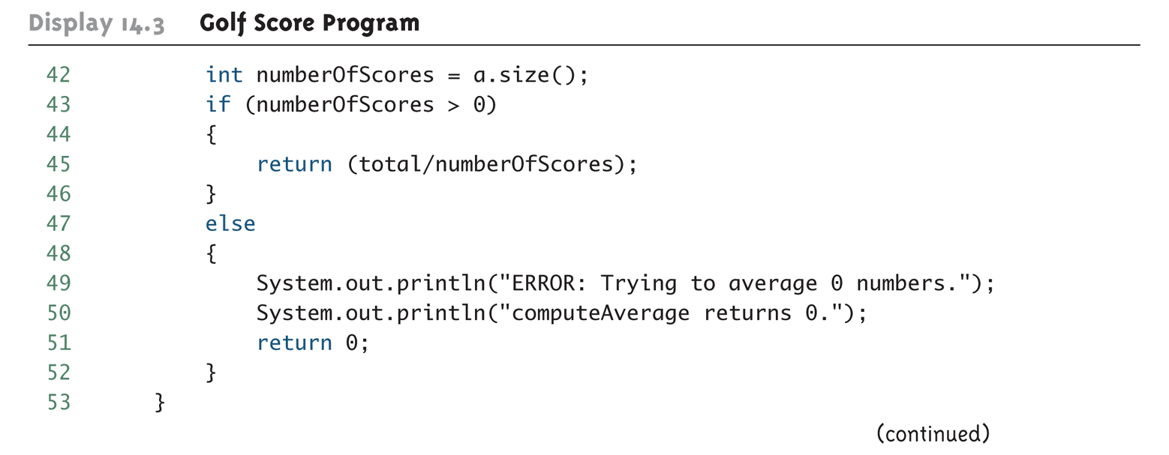
Golf Score Program (Part 4 of 6)

Slide 27
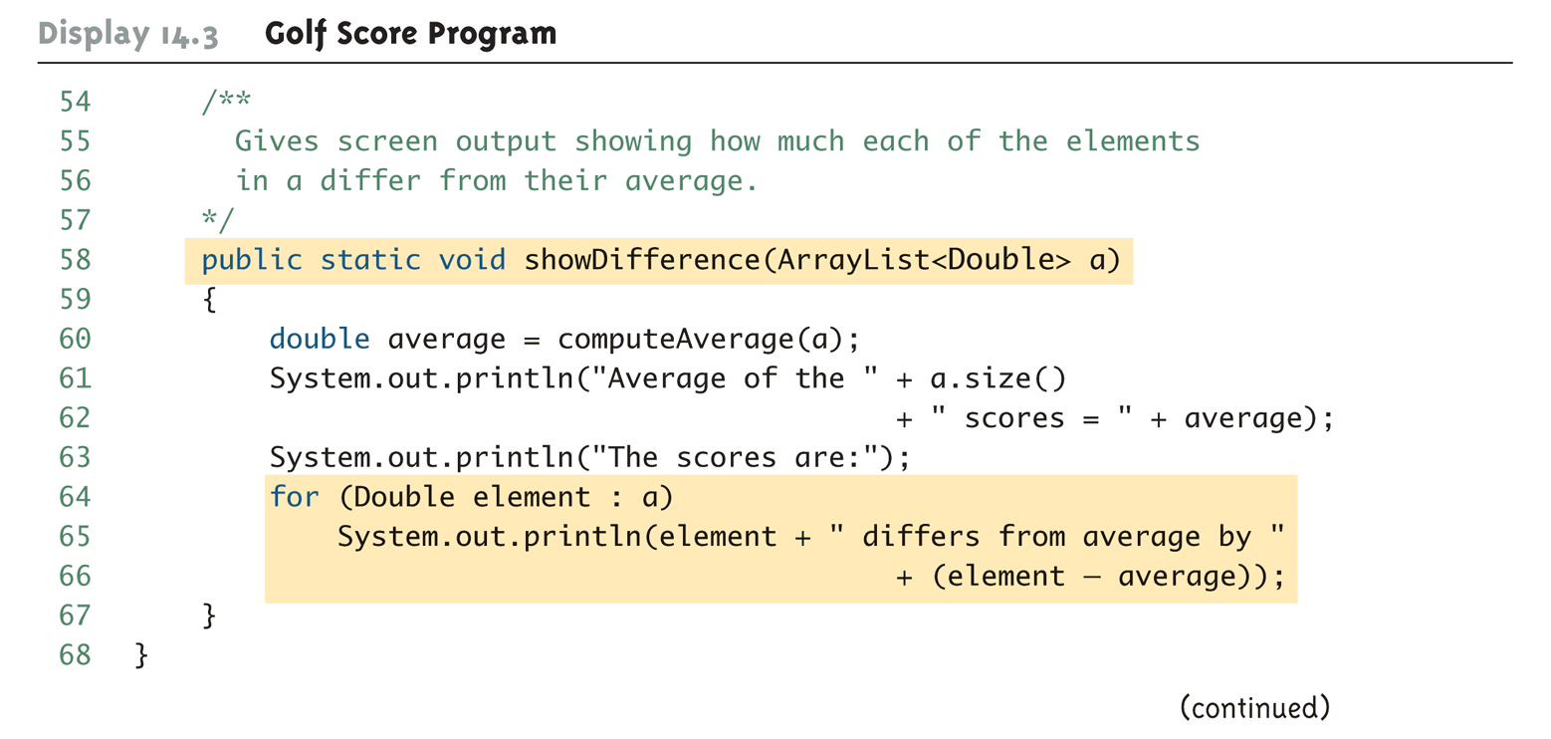
Golf Score Program (Part 5 of 6)

Slide 28
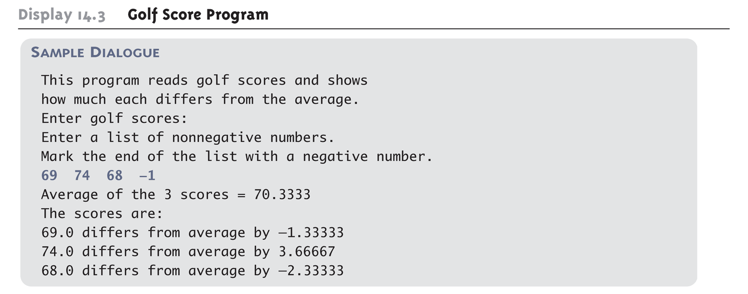
Golf Score Program (Part 6 of 6)

Slide 29
Pitfall: The clone method Makes a Shallow Copy
When a deep copy of an ArrayList is needed, using the clone method is not sufficient
Invoking clone on an ArrayList object produces a shallow copy, not a deep copy
In order to make a deep copy, it must be possible to make a deep copy of objects of the base type
Then a deep copy of each element in the ArrayList can be created and placed into a new ArrayList object

Slide 30
Wrapper Classes
Copyright © 2008 Pearson Addison-Wesley. All rights reserved
5-30
Wrapper classes provide a class type corresponding to each of the primitive types
This makes it possible to have class types that behave somewhat like primitive types
The wrapper classes for the primitive types byte, short, long, float, double, and char are (in order) Byte, Short, Long, Float, Double, and Character
Wrapper classes also contain a number of useful predefined constants and static methods
Notes:
30

Slide 31
ArrayList <Integer> list = new ArrayList<Integer> (19);
List.add(new Integer(6));
List.add(6);
Integer x_obj= list.get(0);
int x = x_obj.intValue();
int x = list.get(0);

Slide 32
Wrapper Classes
Copyright © 2008 Pearson Addison-Wesley. All rights reserved
5-32
Boxing: the process of going from a value of a primitive type to an object of its wrapper class
To convert a primitive value to an "equivalent" class type value, create an object of the corresponding wrapper class using the primitive value as an argument
The new object will contain an instance variable that stores a copy of the primitive value
Unlike most other classes, a wrapper class does not have a no-argument constructor
Integer integerObject = new Integer(42);
Notes:
32

Slide 33
Wrapper Classes
Unboxing: the process of going from an object of a wrapper class to the corresponding value of a primitive type
The methods for converting an object from the wrapper classes Byte, Short, Integer, Long, Float, Double, and Character to their corresponding primitive type are (in order) byteValue, shortValue, intValue, longValue, floatValue, doubleValue, and charValue
None of these methods take an argument
int i = integerObject.intValue();
Copyright © 2008 Pearson Addison-Wesley. All rights reserved
5-33
Notes:
33

Slide 34
Automatic Boxing and Unboxing
Copyright © 2008 Pearson Addison-Wesley. All rights reserved
5-34
Starting with version 5.0, Java can automatically do boxing and unboxing
Instead of creating a wrapper class object using the new operation (as shown before), it can be done as an automatic type cast:
Integer integerObject = 42;
Instead of having to invoke the appropriate method (such as intValue, doubleValue, charValue, etc.) in order to convert from an object of a wrapper class to a value of its associated primitive type, the primitive value can be recovered automatically
int i = integerObject;
Notes:
34

Slide 35
Automatic Boxing and Unboxing
ArrayList<Integer> array = new ArrayList<Integer> (2);
array.add(5);
array.add(6);
int x = array.get(1);

Slide 36
END

